Slide 1
BIOMEDICAL IMAGING (ECE 1023) PROJECT PRESENTATION TOPIC: DIGITAL SUBTRACTION ANGIOGRAM IMAGE ANALYSIS
BY:
AMISH SHRIVASTAVA -18BML0014
PIYUSH GUPTA -18BML0027
SUKARN PAHUJA - 18BML0048

Slide 2
INTRODUCTION
Digital subtraction angiography (DSA) is a fluoroscopic technique used extensively in interventional radiology for visualising blood vessels. Radiopaque structures such as bones are eliminated ("subtracted") digitally from the image, thus allowing for accurate depiction of the blood vessels.
Helps to detect a problem with blood flow. The procedure involves inserting a catheter (a small, thin tube) into an artery in the leg and passing it up to the blood vessels in the brain. A contrast dye is injected through the catheter and X-ray images are taken of the blood vessels.

Slide 3
TIMELINE
REVIEW-1: Research Work (10 Papers Each)
REVIEW-2: 60% MATLAB Implementation to produce a DSA Image
REVIEW-3: 100% MATLAB Implementation and working model to produce DSA image.

Slide 4
REVIEW-1 RESEARCH WORK

Slide 5
TITLE | AUTHOR | YEAR | DESCRIPTION
1.Automatic flow analysis of digital subtraction angiography using independent component analysis in patients with carotid stenosis | Han-Jui Lee, Jia-Sheng Hong , Chung-Jung Lin, Yi-Hsuan Kao, Feng-Chi Chang, Chao-Bao Luo, Wei-Fa Chu | 2017 | (DSA) provides intravascular flow information but requires manual vasculature selection. We developed an angiographic marker that represents cerebral perfusion by using automatic independent component analysis. For all patients with carotid stenosis, magnetic resonance perfusion (MRP) was performed one day before DSA. Fixed contrast injection protocols and DSA acquisition parameters were used before stenting.
2. Closed-Cell Stent-Assisted Coiling of Intracranial Aneurysms: Evaluation of Changes in Vascular Geometry Using Digital Subtraction Angiography | Ebba Beller1 , David Klopp , Jens Göttler, Johannes Kaesmacher , Claus Zimmer , Jan S. Kirschke , Sascha Prothmann | 2016 | 31 patients with 34 aneurysms underwent SACE with closed-cell design stents. Inflow angle α, determined by aneurysm neck and afferent vessel, and angle between afferent and efferent vessel close to (δ1), respectively, more remote from the aneurysm neck (δ2) were graphically determined in 2D angiography projections.

Slide 6
TITLE | AUTHOR | YEAR | DESCRIPTION
3. Image Quality, Radiation Dose, and Comparison With 3D Rotational Digital Subtraction Angiography | Long-Jiang Zhang, Sheng-Yong Wu, Jing-Bo Niu, Zhuo-Li Zhang, Henry Z. Wang, Yan-E Zhao, Xue Chai Chang-Sheng Zhou ,Guang-Ming Lu. | 2010 | Forty-six patients with clinically suspected intracranial aneurysms underwent dual-source dual-energy CTA and 3D DSA. Aneurysm detection with dual-energy CTA compared with 3D DSA was analyzed on a per-patient and on a peraneurysm basis.
4. Locally adaptive image enhancement for digital subtraction x-ray imaging | Martin Spahn, Chicago, IL (US) | 2012 | Digital Subtraction angiography is used to display vessel structures. Subsequently, the Subtracted images may be locally altered to compensate for the local level of absorption such that the visibility of a vessel structure or interventional object is enhanced. The Subtracted images is enhanced by altering the local contrast, brightness, or sharpness, or noise.

Slide 7
TITLE | AUTHOR | YEAR | DESCRIPTION
5.Parametric Color Coding of Digital Subtraction Angiography | C.M. Strother F. Bender Y. Deuerling-Zheng K. Royalty K.A. Pulfer J. Baumgart M. Zellerhoff B. Aagaard-Kienitz D.B. Niemann M.L. Lindstrom | 2010 | The impact of a color-coding algorithm was examined on the interpretation of 2D-DSA acquisitions by experienced and inexperienced observers. Twenty-six 2D-DSA acquisitions obtained as part of routine clinical care from subjects with a variety of cerebrovascular disease processes were selected. . Observers were then asked a series of questions designed to assess the value of the color-coded images
6.Periapical healing after simplified endodontic treatments: A digital subtraction radiography study | Daniele Angerame , Matteo De Biasi , Davide Sossi , Luca Marigo , Raffaella Castagnola , Francesco Somma , Attilio Castaldo | 2013 | Eighty-four patients with chronic periapical pathosis were randomly allocated to two groups and received endodontic treatment. Six months later, clinical examination and DSR analysis were performed. Non-parametric statistical methods were used

Slide 8
TITLE | AUTHOR | YEAR | DESCRIPTION
7. Image Quality and Stenosis Assessment of Non-Contrast-Enhanced 3-T Magnetic Resonance Angiography in Patients with Peripheral Artery Disease Compared with Contrast-Enhanced Magnetic Resonance Angiography and Digital Subtraction Angiography | Jiayi Liu1 , Nan Zhang, Zhaoyang Fan , Nan Luo , Yike Zhao, Xiaoming Bi , Jing An, Zhong Chen , Dongting Liu1 , Zhaoying Wen1 , Zhanming Fan1, Debiao Li. | 2016 | A series of 16 consecutive patients with peripheral arterial disease (PAD) underwent a combined peripheral MRA protocol consisting of FSD-MRA for the calves and large field-of-view CE-MRA. DSA was performed on all patients within 1 week of the MR angiographies.
8. Peritherapeutic quantitative flow analysis of arteriovenous malformation on digital subtraction angiography | Tzung-Chi Huang, PhD,a Tung-Hsin Wu, PhD,b Chung-Jung Lin, MD,c Greta S. P. Mok, PhD,d and Wan-Yuo Guo, MD, PhD | 2012 | Digital subtraction angiography (DSA) provides detailed hemodynamic information. However, the imaging interpretation is mainly based on the physician’s experience and observation. In this research it aimed to quantitatively study the peritherapeutic blood flow changes of a cerebral arteriovenous malformation (AVM) treated by embolization using optical flow estimation on DSA

Slide 9
TITLE | AUTHOR | YEAR | DESCRIPTION
9. Comparison between digital subtraction angiography and magnetic resonance angiography in investigation of nonlinear ischemic stroke in young patients. | Adriana Bastos Conforto, Felipe Fregni, Paulo Puglia Jr., Claudia da Costa Leite, Fabio Iuji Yamamoto, Karen F. Coracini, Milberto Scaff. | 2016 | investigated the relevance of performing digital subtraction angiography (DSA) in addition to magnetic resonance angiography (MRA) in definition of ischemic stroke etiology in young patients. DSAs and MRAs from 17 young patients with nonlacunar ischemic stroke were blindly analysed and their impact on stroke management was evaluated.
10. Quantification of Blood Flow in Internal Cerebral Artery by Optical Flow Method on Digital Subtraction Angiography in Comparison with Time-Of-Flight Magnetic Resonance Angiography | Tzung-Chi Huang, Chih-Kai Chang, Chun-Han Liao , Yung-Jen Ho | 2013 | This study compared data on the blood flow velocity in the internal carotid artery, which was obtained using the optical flow method (OFM) with digital subtraction angiography (DSA) and the time-of-flight (TOF) technique using magnetic resonance angiography (MRA). Images were obtained from 12 cerebrovascular patients who underwent both brain DSA. The OFM was applied on the DSA images to determine the average blood flow velocity.

Slide 10
TITLE | AUTHOR | YEAR | DESCRIPTTION
11. Treatment Evaluation of Flow-Limiting Stenoses of the Superficial Femoral and Popliteal Artery by Parametric Color-Coding Analysis of Digital Subtraction Angiography Series | Michael Kostrzewa, Kerim Kara, Lothar Pilz, Hannelore Mueller-Muertz, Nils Rathmann, Stefan O. Schoenberg, Steffen J. Diehl. | 2017 | DSA series of SFA or PA of patients with symptomatic peripheral arterial occlusive disease was obtained with a flat-panel angiography system with intention-to-treat. In DSA series acquired before and after PTI, TDCs were analyzed proximal and distal of each stenosis using parametric color coding (PCC). For correlation, ABI and PSVR measurements pre- and post-PTI were recorded for all patients.
12. Towards Quantitative Analysis of Digital Subtraction Angiography (DSA) Image Data | Jiayu Liang, Fengyun Gu, George C Newman, Finbarr O'Sullivan | 2019 | 2 images of a region of the body were compared before and after a contrast medium was injected. Full-level 2-D dataset with 26 time frame were generated. Raw data was explored in Region Of Intrest (ROI).Later, the data was transformed in R and time course of ROI from the arterial vessel .

Slide 11
TITLE | AUTHOR | YEAR | DESCRIPTION
13. Safety of Diagnostic Cerebral and Spinal Digital Subtraction Angiography in a Developing Country: A Single-Center Experience | Qasim Bashira, Asim Ishfaq, Ammad Anwar Baig | 2017 | A retrospective review of patient demographics, procedural technique and complication rates of 286 consecutive patients undergoing the diagnostic cerebral/spinal digital subtraction angiography procedure at one institution from May 2013 to December 2015 was performed. Neurological, systemic, or local complications occurring within and after 24 hours of the procedure were recorded.
14. Quantitative Digital Subtraction Angiography in Pediatric Moyamoya Disease | Jung-Eun Cheon, M.D. | 2015 | The DSA images were color-coded using the post processing software Syngo iFlow . The software provides a single colored-composite image that shows the path of the movement of contrast medium though the vessels in time. For quantitative analysis, regions of interest (ROI) were placed on the colored image. The software calculated relative opacity data per ROI per time point. QDSA has been used to access the peritherapeutic hemodynamics inthe various vascular disorders including steno-occlusive arterial disease in an angiographic suite.

Slide 12
TITLE | AUTHOR | YEAR | DESCRIPTION
15. Evaluation of a Noise Reduction Imaging Technology in Iliac Digital Subtraction Angiography: Noninferior Clinical Image Quality with Lower Patient and Scatter Dose | Marco J. van Strijen, Thijs Grünhagen, Maria Mauti, Markus Zähringer, Peter A. Gaines, Graham J. Robinson, Nicholas J. Railton, Hans van Overhagen, Jan Habraken and Marc van Leersum | 2015 | Imaging using two randomly ordered DSA runs was performed in 51 adults scheduled for iliac artery angiography or intervention or both. One DSA run used standard acquisition chain and image processing algorithms and the other DSA run used dose-reduction and real-time advanced image noise reduction technology. The quality of each pair of runs, consecutively performed without changes in working projection or injection parameters, was independently rated by five radiologists blinded to the imaging technology used. Patient radiation dose was evaluated using air kerma and dose area product, and scatter dose was evaluated using three dosimeters located at fixed positions.
16. Digital Subtraction Angiography– Guided Foam Sclerotherapy of Peripheral Venous Malformations | Long Li, Xin-Qiao Zeng, Yan-Hao Li, Li L, Zeng XQ, Li YH | 2010 | 14 patients with peripheral venous malformations were treated with foam sclerotherapy. Percutaneous foam sclerotherapy of venous malformations under digital subtraction angiography guidance was performed using a combined technique modified with the double-needle technique and the filling-defects technique. Follow-up clinical and radiologic assessment and evaluation of patientsatisfaction were performed to evaluate the end result.

Slide 13
TITLE | AUTHOR | YEAR | DESCRIPTION
17. A pilot study on adjunctive use of parametric colour-coded digital subtraction angiography in endovascular interventions of haemodialysis access | Ru Yu Tan1, Tze Tec Chong, Fu Chieh Tsai, Suh Chien Pang, Kian Guan Lee, Apoorva Gogna, Alicia Huiying Ong, Chieh Suai Tan | 2018 | They retrospectively studied 20 patients who underwent access intervention and applied parametric colourcoding on selected DSA acquisitions before and after percutaneous transluminal angioplasty (PTA). The difference in time to peak (dTTP) contrast enhancement and time attenuation curve (TAC) of pre- and post-stenotic regions of interest (ROIs) were obtained and compared after treatment.
18. Digital Subtraction CT Angiography for Detection of Intracranial Aneurysms : Comparison with Three-dimensional Digital Subtraction Angiography | Li Lu, Long Jiang Zhang , Colin S. Poon, Sheng Yong Wu, Chang Sheng Zhou, Song Luo, Mei Wang, Guang Ming Lu | 2012 | A total of 513 patients underwent both digital subtraction CT angiography and 3D DSA, with a median interval of 1 day; The sensitivity, specifi city, and accuracy of digital subtraction CT angiography in depicting aneurysm were analyzed on a per-patient and per-aneurysm basis, with 3D DSA as the reference standard. The sensitivity, specificity, and accuracy of digital subtraction CT angiography in depicting aneurysms of different diameter and of aneurysms at different locations in the anterior and posterior circulation were calculated.

Slide 14
TITLE | AUTHOR | YEAR | DESCRIPTION
19. Image Noise Reduction Algorithm for Digital Subtraction Angiography: Clinical Results | Michael Söderman, Staffan Holmin, Tommy Andersson, Charlotta Palmgren, Draženko Babić, Bart Hoornaert | 2013 | DSA was performed with the default reference DSA program, a quarter-dose DSA program with modified acquisition parameters and a real-time noise-reduction algorithm. Two consecutive biplane DSA data sets were acquired in each patient. The dose-area product (DAP) was calculated for each image and compared. A randomized, blinded, offline reading study was conducted to show noninferiority of the quarter-dose image sets. Overall, 40 samples per treatment group were necessary to acquire 80% power, which was calculated by using a one-sided a level of 2.5%.
20. Developmental venous anomalies: appearance on whole-brain CT digital subtraction angiography and CT perfusion | Eric H. Hanson, Cayce J. Roach, Erik N. Ringdahl, Brad L. Wynn, Sean M. DeChancie, Nathan D. Mann, Alan S. Diamond, William W. | 2010 | CT data sets of ten anonymized patients were retrospectively analyzed. CT angiograms, CT arterialvenous views, 4-D CT DSA and CTP maps were acquired on a dynamic volume imaging protocol on a 320-detector row hemodynamic parameters and capture the anomalies in superior cortices of the cerebrum and the cerebellum. Future research may identify the rare subsets of patients at increased risk of adverse outcomes secondary to the altered hemodynamics to facilitate tailored imaging surveillance and application of appropriate preventive therapeutic measures

Slide 15
TITLE | AUTHOR | YEAR | DESCRIPTION
21.4D Digital Subtraction Angiography_ Implementation | B. Davis, K. Royalty | 2013 | Typically, 30 temporal volumes per second are generated with the use of currently available flat detector systems, a factor of ∼200 increase over that achievable with the use of multiple gantry rotations. Dynamic displays of the reconstructed volumes are viewable from any angle. Good results have been obtained by using both intraarterial and intravenous injections.
22.Comparative study between multi-detector CT and DSA | Omran Khodary Qenawy a,Wahid Hussein Tantawy b Abdel Karem Hasan Abdalla a ,Samy Abdel Aziz Sayed | 2015 | Using MDCT-A, the arterial tree of the lower extremity was evaluated for the presence of steno-occlusive lesions that might have led to luminal stenosis. The diagnostic accuracy of MDCTA was calculated and compared with that of DSA.

Slide 16
TITLE | AUTHOR | YEAR | DESCRIPTION
23.A Fast image registeration algorithm for DSA | Mansour Nejati, Rassoul Amirfattahi, Saeed Sadri | 2010 | Selection of a set of control points on the live image by using a combination of edge-based approach and Harris corner detector. The displacements control points computed. Entropy of histogram of differences is exploited
24.Computed Tomography Angiography Versus Digital subtraction angiography | Matthew Uricchio, PharmDCandidate; Saksham Gupta; NicholasJakoweno ; Marissa Levito . | 2019 | A comprehensive literature search was conducted that evaluated postclipping aneurysm obliteration with both computed tomographic angiography and digital subtraction angiography. Pooled sensitivity, specificity, positive likelihood ratio (LR+), and negative likelihood ratio (LR−) were calculated using the bivariate random-effects model.

Slide 17
TITLE | AUTHOR | YEAR | DESCRIPTION
25.DSA method using contrast-motion estimation for the Assessment of the Intra-Aneurysmal Flow Changes Induced by Flow-Diverter Stents. | V.M. Pereira, O. Bonnefous, R. Ouared, O. Brina, J. Stawiaski, H. Aerts, D. Ruijters, A.P. Narata, P. Bijlenga, K. Schaller, and K.-O. Lovblad | 2013 | 24 patients were recruited s with unruptured IAs who underwent FDS implantation.The quantification of arterial and intraaneurysmal flow was accomplished.Flow reduction was assessed . The correlation between the MAFA ratio and the incidence of aneurysm thrombosis was assessed afterwards.
26.Dual-Energy CT Angiography in the Evaluation of Intracranial Aneurysms: Image Quality, Radiation Dose, and Comparison With 3D Rotational Digital Subtraction Angiography | Long-Jiang Zhang1 Sheng-Yong Wu2 zing-Bo Niu3 Zhuo-Li Zhang1 Henry Z. Wang4 Yan-E Zhao1 Xue Chai1 Chang-Sheng Zhou1 Guang-Ming Lu1 | 2010 | 46 patients who underwent digital subtraction CTA were recruited as a control group. The image quality of dual-energy CTA and digital subtraction CTA was rated on a 4-point scale as excellent, good, moderate, or poor. The radiation dose of CTA was recorded according to patient protocol.

Slide 18
TITLE | AUTHOR | YEAR | DESCRIPTION
27.Hepatic arterial mapping by ct angiography, cone beam ct and digital subtraction angiography | Irfan A, Weir G | 2016 | 39 patients underwent work up for Selective Internal Radiotherapy. All had CT Angiography and Digital Subtraction Angiography (DSA) carried out and 22/39 underwent a DynaCT scan.
28.Imaging of cerebral aneurysms: a clinical perspective | Nam K. Yoon, Scott McNally , Philipp Taussky and Min S. Park | 2016 | Evaluation of subarachnoid hemorrhage is done first.Then Detection of cerebral aneurysm is carried out.Additionally, the angiomorphology of the aneurysm has also been posited to influence future hemorrhage risk factors, such as irregular domes,daughter sacs, and low wall shear stress.

Slide 19
TITLE | AUTHOR | YEAR | DESCRIPTION
29.Nonrigid Image Registration in Digital Subtraction Angiography Using Multilevel B-Spline | Mansour Nejati, Saeid Sadri, and Rassoul Amirfattahi | 2013 | Registration of digital angiographic image sequences is proposed. Themethod involves the selection of a set of control points on the live image by using a hybrid approach based on an edge-detection scheme and Harris corner detector.
30.Quantification of Internal Carotid Artery Flow with Digital Subtraction Angiography: Validation of an Optical Flow Approach with Doppler Ultrasound | V. Mendes Pereira, R. Ouared, O. Brina, O. Bonnefous, J. Satwiaski, H. Aerts, D. Ruijters, F. van Nijnatten, F. Perren, P. Bijlenga, K. Schaller, and K.-O. Lovblad | 2014 | We acquired high-frame DSA series to assess the sensitivity of the algorithm to contrast agent-blood mixing dynamics.3D rotational angiography was used to extract the centerline of the vessel and the arterial section.

Slide 20
REVIEW-2 BASIC MATLAB IMPLEMENTATION

Slide 21
IMPLEMENTATION:

Slide 22

Software details:
SOFTWARE USED : MATLAB 2020R
TOOLBOX USED: IMAGE PROCESSING TOOLBOX
TECHNIQUE USED: PARAMETRIC COLOR CODING

Slide 23
INPUTS/OUTPUTS:
INPUT TO THE SOFTWARE : It’s a DSA image showing a transverse projection of the vertebrobasilar and posterior cerebral circulation
OUTPUT FROM THE SOFTWARE: A DSA image showcasing veins in a coloured format is produced as output from the software for further and better analysis.

Slide 24
SIGNIFICANCE OF THE technique used:
color-coding of DSA enhanced the conspicuity of findings on DSA images.
It is particularly useful in situations in which there was a complex flow pattern and in evaluation of pre- and posttreatment acquisitions.

Slide 25
DEMONSTRATION:

Slide 26
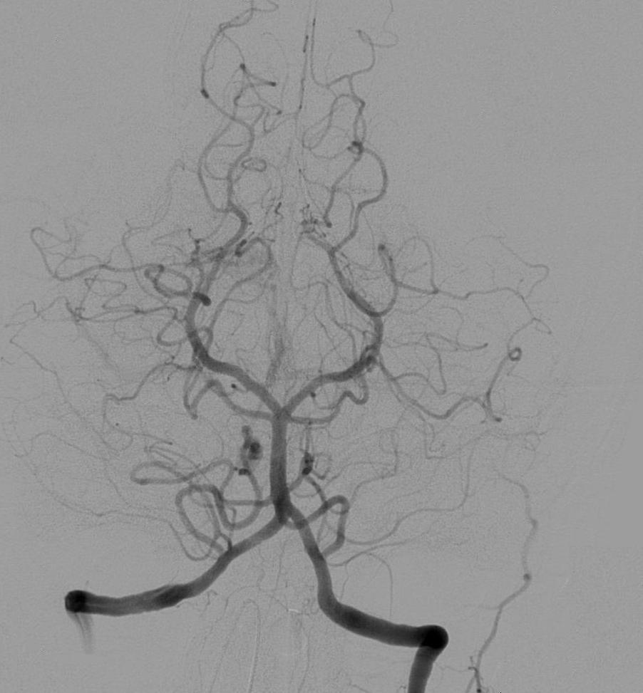
INPUT IMAGE:

Slide 27
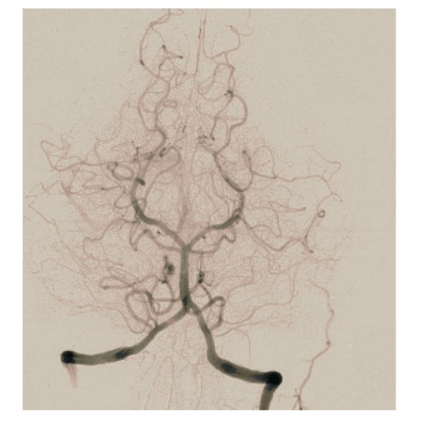
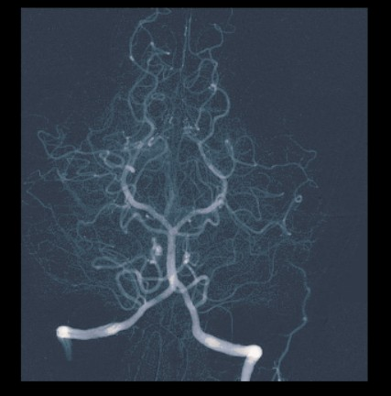
OUTPUT IMAGE:

Slide 28
MATLAB CODE-1: (Image Colouring)
clc;
clear all;
% im=input('Enter the file name (gray level image) :','s');
k=imread('dsa.jpeg');
[x y z]=size(k);
% z should be one for the input image
k=double(k);
for i=1:x
for j=1:y
if k(i,j)>=0 & k(i,j)<50
m(i,j,1)=k(i,j,1)+5;
m(i,j,2)=k(i,j)+10;
m(i,j,3)=k(i,j)+10;
end
if k(i,j)>=50 & k(i,j)<100
m(i,j,1)=k(i,j)+35;
m(i,j,2)=k(i,j)+28;
m(i,j,3)=k(i,j)+10;
end

Slide 29
if k(i,j)>=100 & k(i,j)<150
m(i,j,1)=k(i,j)+52;
m(i,j,2)=k(i,j)+30;
m(i,j,3)=k(i,j)+15;
end
if k(i,j)>=150 & k(i,j)<200
m(i,j,1)=k(i,j)+50;
m(i,j,2)=k(i,j)+40;
m(i,j,3)=k(i,j)+25;
end
if k(i,j)>=200 & k(i,j)<=256
m(i,j,1)=k(i,j)+120;
m(i,j,2)=k(i,j)+60;
m(i,j,3)=k(i,j)+45;
end
end
end
figure,imshow(uint8(k),[]);
title('Input image');
figure,imshow(uint8(m),[]);
title('Coloured Image');
x=imread('output_angio.jpeg');
y(:,:,:)=255-x(:,:,:);
figure;
imshow(y);

Slide 30
MATLAB CODE-2: (COLOUR_CODING)
clc;
clear all;
close all;
x=imread('output_angio.jpeg');
y(:,:,:)=255-x(:,:,:);
figure;
imshow(y);

Slide 31
FURTHUR ASPECTS:

Slide 32
In the final review, i.e, Review-3 , we are going to make the following modifications to improve the output angiographic image:
Noise Reduction: we will be using functions to remove noise and make the visibility of veins more clear and brighter.
Image Enhancement: The contrast and the brightness level of the image will be improved for better image quality.

Slide 33
REVIEW-3 FINAL WORKING MODEL

Slide 34
PROJECT DETAILS:

Slide 35
Software details:
SOFTWARE USED : MATLAB 2020R
TOOLBOX USED: IMAGE PROCESSING TOOLBOX
TECHNIQUE USED: PARAMETRIC COLOR CODING

Slide 36
INPUTS/OUTPUTS:
INPUT TO THE SOFTWARE : It’s a DSA image showing a transverse projection of the vertebrobasilar and posterior cerebral circulation
OUTPUT FROM THE SOFTWARE: A DSA image showcasing veins in a coloured format is produced as output from the software for further and better analysis.

Slide 37
SIGNIFICANCE OF THE technique used:
color-coding of DSA enhanced the conspicuity of findings on DSA images.
It is particularly useful in situations in which there was a complex flow pattern and in evaluation of pre- and posttreatment acquisitions.

Slide 38
RESULTS:

Slide 39
INPUT IMAGE:

Slide 40
COLOURED IMAGE:

Slide 41
COLOUR CODED DSA IMAGE:

Slide 42
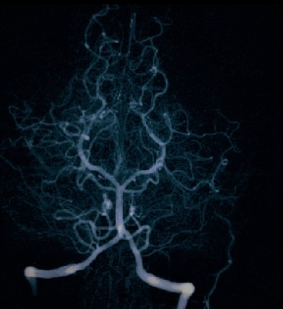
ENHANCED DSA IMAGE

Slide 43
MATLAB CODE: (Coloured image)
clc;
clear all;
close all;
%Reads the input image
k=imread('dsa.jpeg');
[x y z]=size(k);
k=double(k);
for i=1:x
for j=1:y
if k(i,j)>=0 & k(i,j)<50
m(i,j,1)=k(i,j,1)+5;
m(i,j,2)=k(i,j)+10;
m(i,j,3)=k(i,j)+10;
end
if k(i,j)>=50 & k(i,j)<100
m(i,j,1)=k(i,j)+35;
m(i,j,2)=k(i,j)+28;
m(i,j,3)=k(i,j)+10;
End
if k(i,j)>=100 & k(i,j)<150
m(i,j,1)=k(i,j)+52;
m(i,j,2)=k(i,j)+30;
m(i,j,3)=k(i,j)+15;
end
if k(i,j)>=150 & k(i,j)<200
m(i,j,1)=k(i,j)+50;
m(i,j,2)=k(i,j)+40;
m(i,j,3)=k(i,j)+25;
end
if k(i,j)>=200 & k(i,j)<=256
m(i,j,1)=k(i,j)+120;
m(i,j,2)=k(i,j)+60;
m(i,j,3)=k(i,j)+45;
end
end
end
%Plotting of input images.
subplot(2,2,1)
imshow(uint8(k),[]);
title('INPUT DSA IMAGE');
subplot(2,2,2)
imshow(uint8(m),[]);
title('COLOURED DSA IMAGE');

Slide 44
MATLAB CODE: (Colour coded image)
%COLOUR CODED DSA IMAGE
x=imread('output_angio.jpeg');
r(:,:,:)=255-x(:,:,:);
subplot(2,2,3)
imshow(r);
title(“COLOUR CODED DSA IMAGE");

Slide 45
MATLAB CODE: (ENHANCED DSA image)
%ENHANCED DSA IMAGE
x=imread("review2_output.jpeg")
z=0.8*(x-55);
subplot(2,2,4)
imshow(z);
title("ENHANCED DSA IMAGE");
%PLOTTING OF IMAGES SEPERATELY
figure;
imshow(uint8(k),[]);
title('INPUT DSA IMAGE');
figure;
imshow(uint8(m),[]);
title('COLOURED DSA IMAGE');
figure;
imshow(r);
title("IMPROVED DSA IMAGE");
figure;
imshow(z);
title("ENHANCED DSA IMAGE");

Slide 46
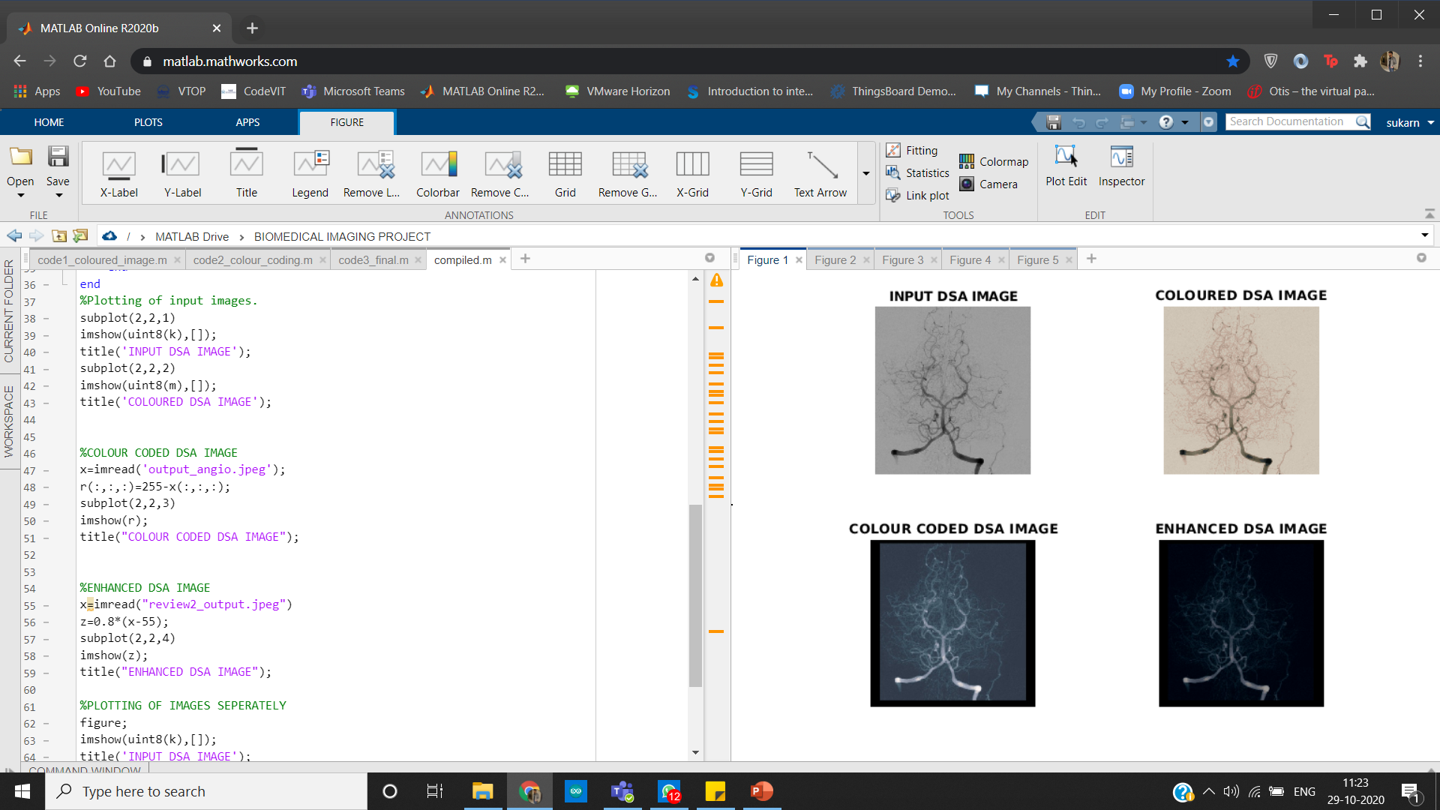
MATLAB OUTPUT: (SUBPLOT)

Slide 47
CONCLUSION
COLOUR CODING: colour coding was done successfully and it becomes easier to analyse the complex flow patterns
Noise Reduction: appropriate functions was used to remove noise and make the visibility of veins more clear and brighter.
Image Enhancement: The contrast and the brightness level of the image was improved for better image quality.

Slide 48
THANK YOU

